Slide 1
JBL CSM-32 & CSM21
Public Address Mixer
David Stevens – Harman pro service
Lead Service Technician SPbU

Slide 2
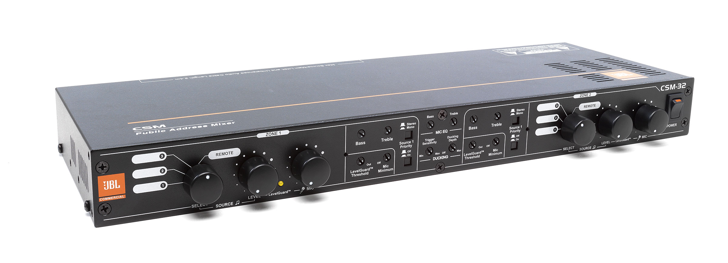
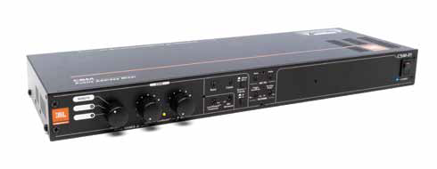
JBL CSM-32 & 21
Checkout the JBL CSM-32 & 21 User Manual and online Literature for more information

Slide 3
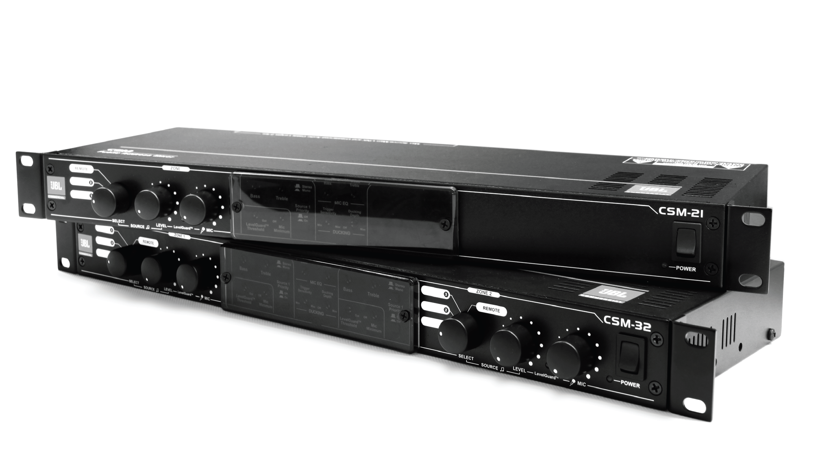
JBL CSM-32 & 21

Slide 4
JBL CSM-32 & 21 Overview
The JBL® Commercial CSM-32 offers fixed I/O, pre-configured architecture, full stereo or mono operation, flexible routing and control of multiple audio sources, simple front-panel configuration and control without the need for a computer, compatibility with the CSR wall controllers, compatibility with the CSPM paging microphones, and optional duplication of audio channels to another device via a Cat5 cable.
The CSM-32 features three stereo music inputs with gain control and clip LEDs, and two stereo outputs with active crossovers and dedicated subwoofer outputs.
Two additional inputs are provided for music override. First, a mic input with phantom power and gain control allows page steering to different zones, ducking the music by a user-configurable amount. Second, a line input allows high-priority routing to all zones, which is ideal for alarms.

Slide 5
JBL CSM-32 & 21 Overview
An additional transformer-isolated mono output is provided for connection of a music-only mono output, which is ideal for music-on-hold systems.
Dedicated controls for music EQ per zone and dedicated controls for global mic EQ allow the frequency content of each input type to be customized independently. In each output channel, LevelGuard™ is provided to retain consistent volumes between the various inputs, and AutoWarmth™ is provided to ensure full fidelity at all zone volume levels.
Zone Remote ports 1 and 2 facilitate connection of the CSR wall controllers, which can provide source selection and/or volume control in each output zone. Source select per zone, music level per zone, and mic level per zone can also be controlled on the front panel. For additional control, two logic inputs facilitate page steering and music muting via contact closure.

Slide 6
JBL CSM-32 & 21 Overview
Two RJ-45 Link ports allow multiple CSM devices to be linked to increase the number of output zones. Linking CSM devices shares the inputs from the main devices over Cat5 cable and eliminates the need for Y-cables.
An included security plate can be placed over the front panel controls to avoid uninvited changes to a commissioned system.

Slide 7
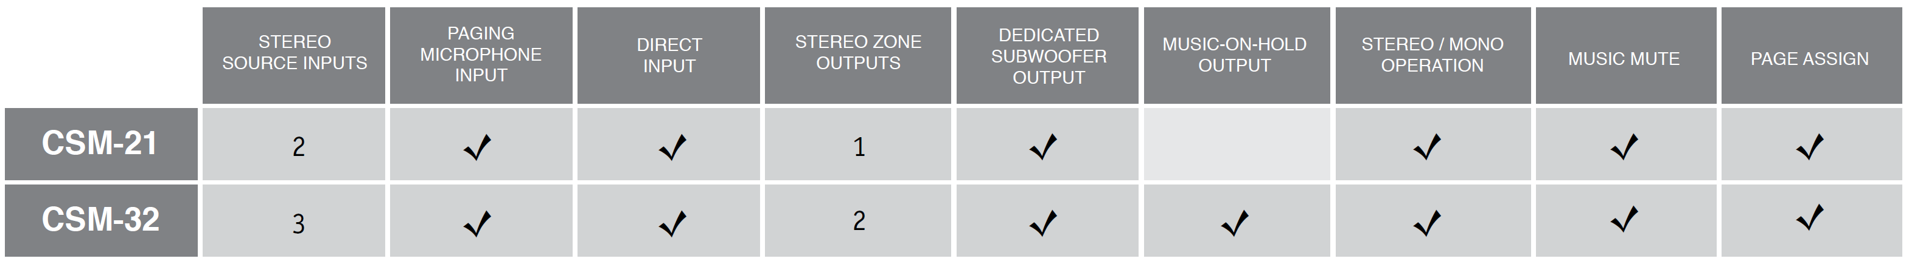
JBL CSM-32 & 21 Overview
The CS Series CSM Public Address Mixers represent affordable, professional business music processing solutions for
simple background music and paging applications. The mixers can be configured for a range of uses such as paging,
background music, and security applications, do not require a computer for configuration and are designed with simple
analog-style controls. An included security plate can be placed over the controls to avoid uninvited changes to a
commissioned system. Three wall controllers are available for the CSM devices, which offer volume control and source
selection from convenient remote locations. Further info about the CS Series family of products, including the CSA
Amplifiers and the CSS Speakers, can be found at www.jblcommercialproducts.com

Slide 8
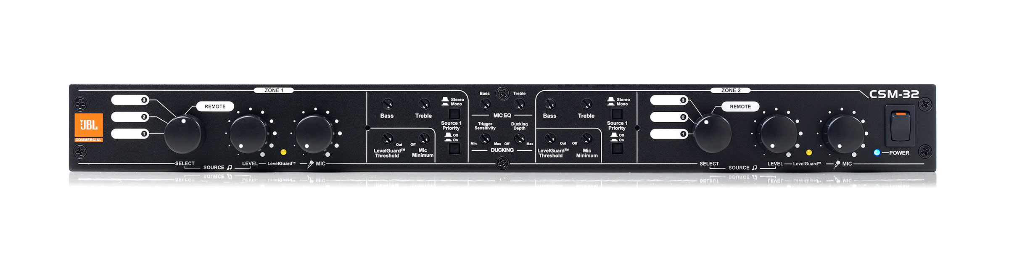
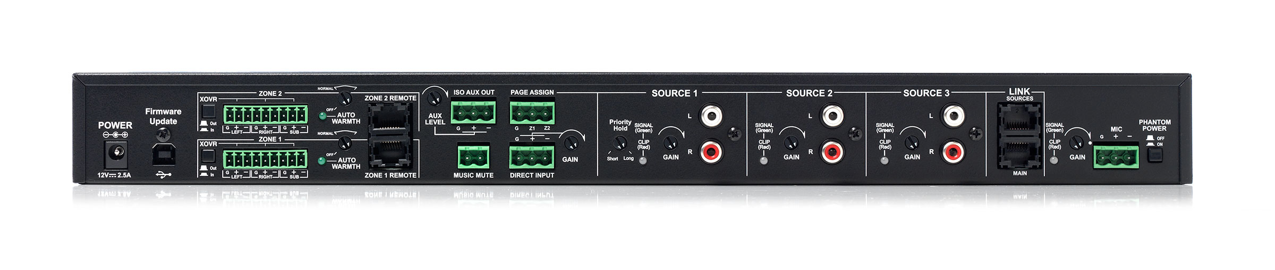
JBL CSM-32 Overview
5 Inputs / 3 Outputs
  3 Stereo Inputs
  1 Mic Input
  1 Line Input for Priority Audio
  2 Stereo Outputs with Dedicated Subwoofer Outputs
  1 Mono Isolated Output for Music-On-Hold System
Quick and Simple Configuration via Front/Rear Panel Controls
Digital Processor with Analog-Style Control
Music EQ (Per Zone)
Mic EQ (Global)
AutoWarmth™ and LevelGuard™ per Output Zone
Control
  Front Panel
  Optional CSR Controllers
  Contact Closure
Link Bus for Input Sharing
Security Plate for Front Panel Lockout (included)

Slide 9
JBL CSM-32 & 21 Overview
E q u a l i z at i o n
Bass and Treble controls are available for the paging microphone and each Zone Output. These controls allow the sound of the microphone to be tailored independently from the sound in each of the zones. This helps ensure crystal clear intelligibility of paging announcements, without impacting the fidelity of the music in the output zones.
A u t o Wa r m t h ™
AutoWarmth helps maintain musical warmth at all operating levels by automatically adjusting the tonal balance within a zone based upon the zone output level. This helps prevent music from sounding thin at lower levels or excessively resonant at higher levels.
Le v e l G u a r d ™
LevelGuard helps maintain optimum levels through the system by automatically applying the correct amount of compression to the source signals based upon the incoming level. Even with source material of different levels, customers experience consistency from the system.

Slide 10
JBL CSM-32 & 21 Overview
S o u r ce P r i o r i t y
There are cases where it is desirable for particular sources to have priority over other sources. Examples of such sources are jukeboxes, message repeaters or live DJ. After some simple configuration on the CSM, the sources will play into the zones as specified until a signal is present on the priority source. The CSM device will automatically fade over to the priority source until a signal is no longer present on the priority source. This means that, for an application with a background music source and a jukebox, no switching from the background music source is required as customers put money in the jukebox. The CSM device automatically fades over to the jukebox immediately as the song starts to play. After the jukebox playlist has finished, the CSM device automatically fades back over to the background music source.
S ec u r i t y P a n e l
Once everything is set up exactly the way you like it, the included security plate can be placed over the controls in the center of the CSM device to avoid uninvited changes. This means that the system will consistently deliver the same high performance as the day it was commissioned.

Slide 11
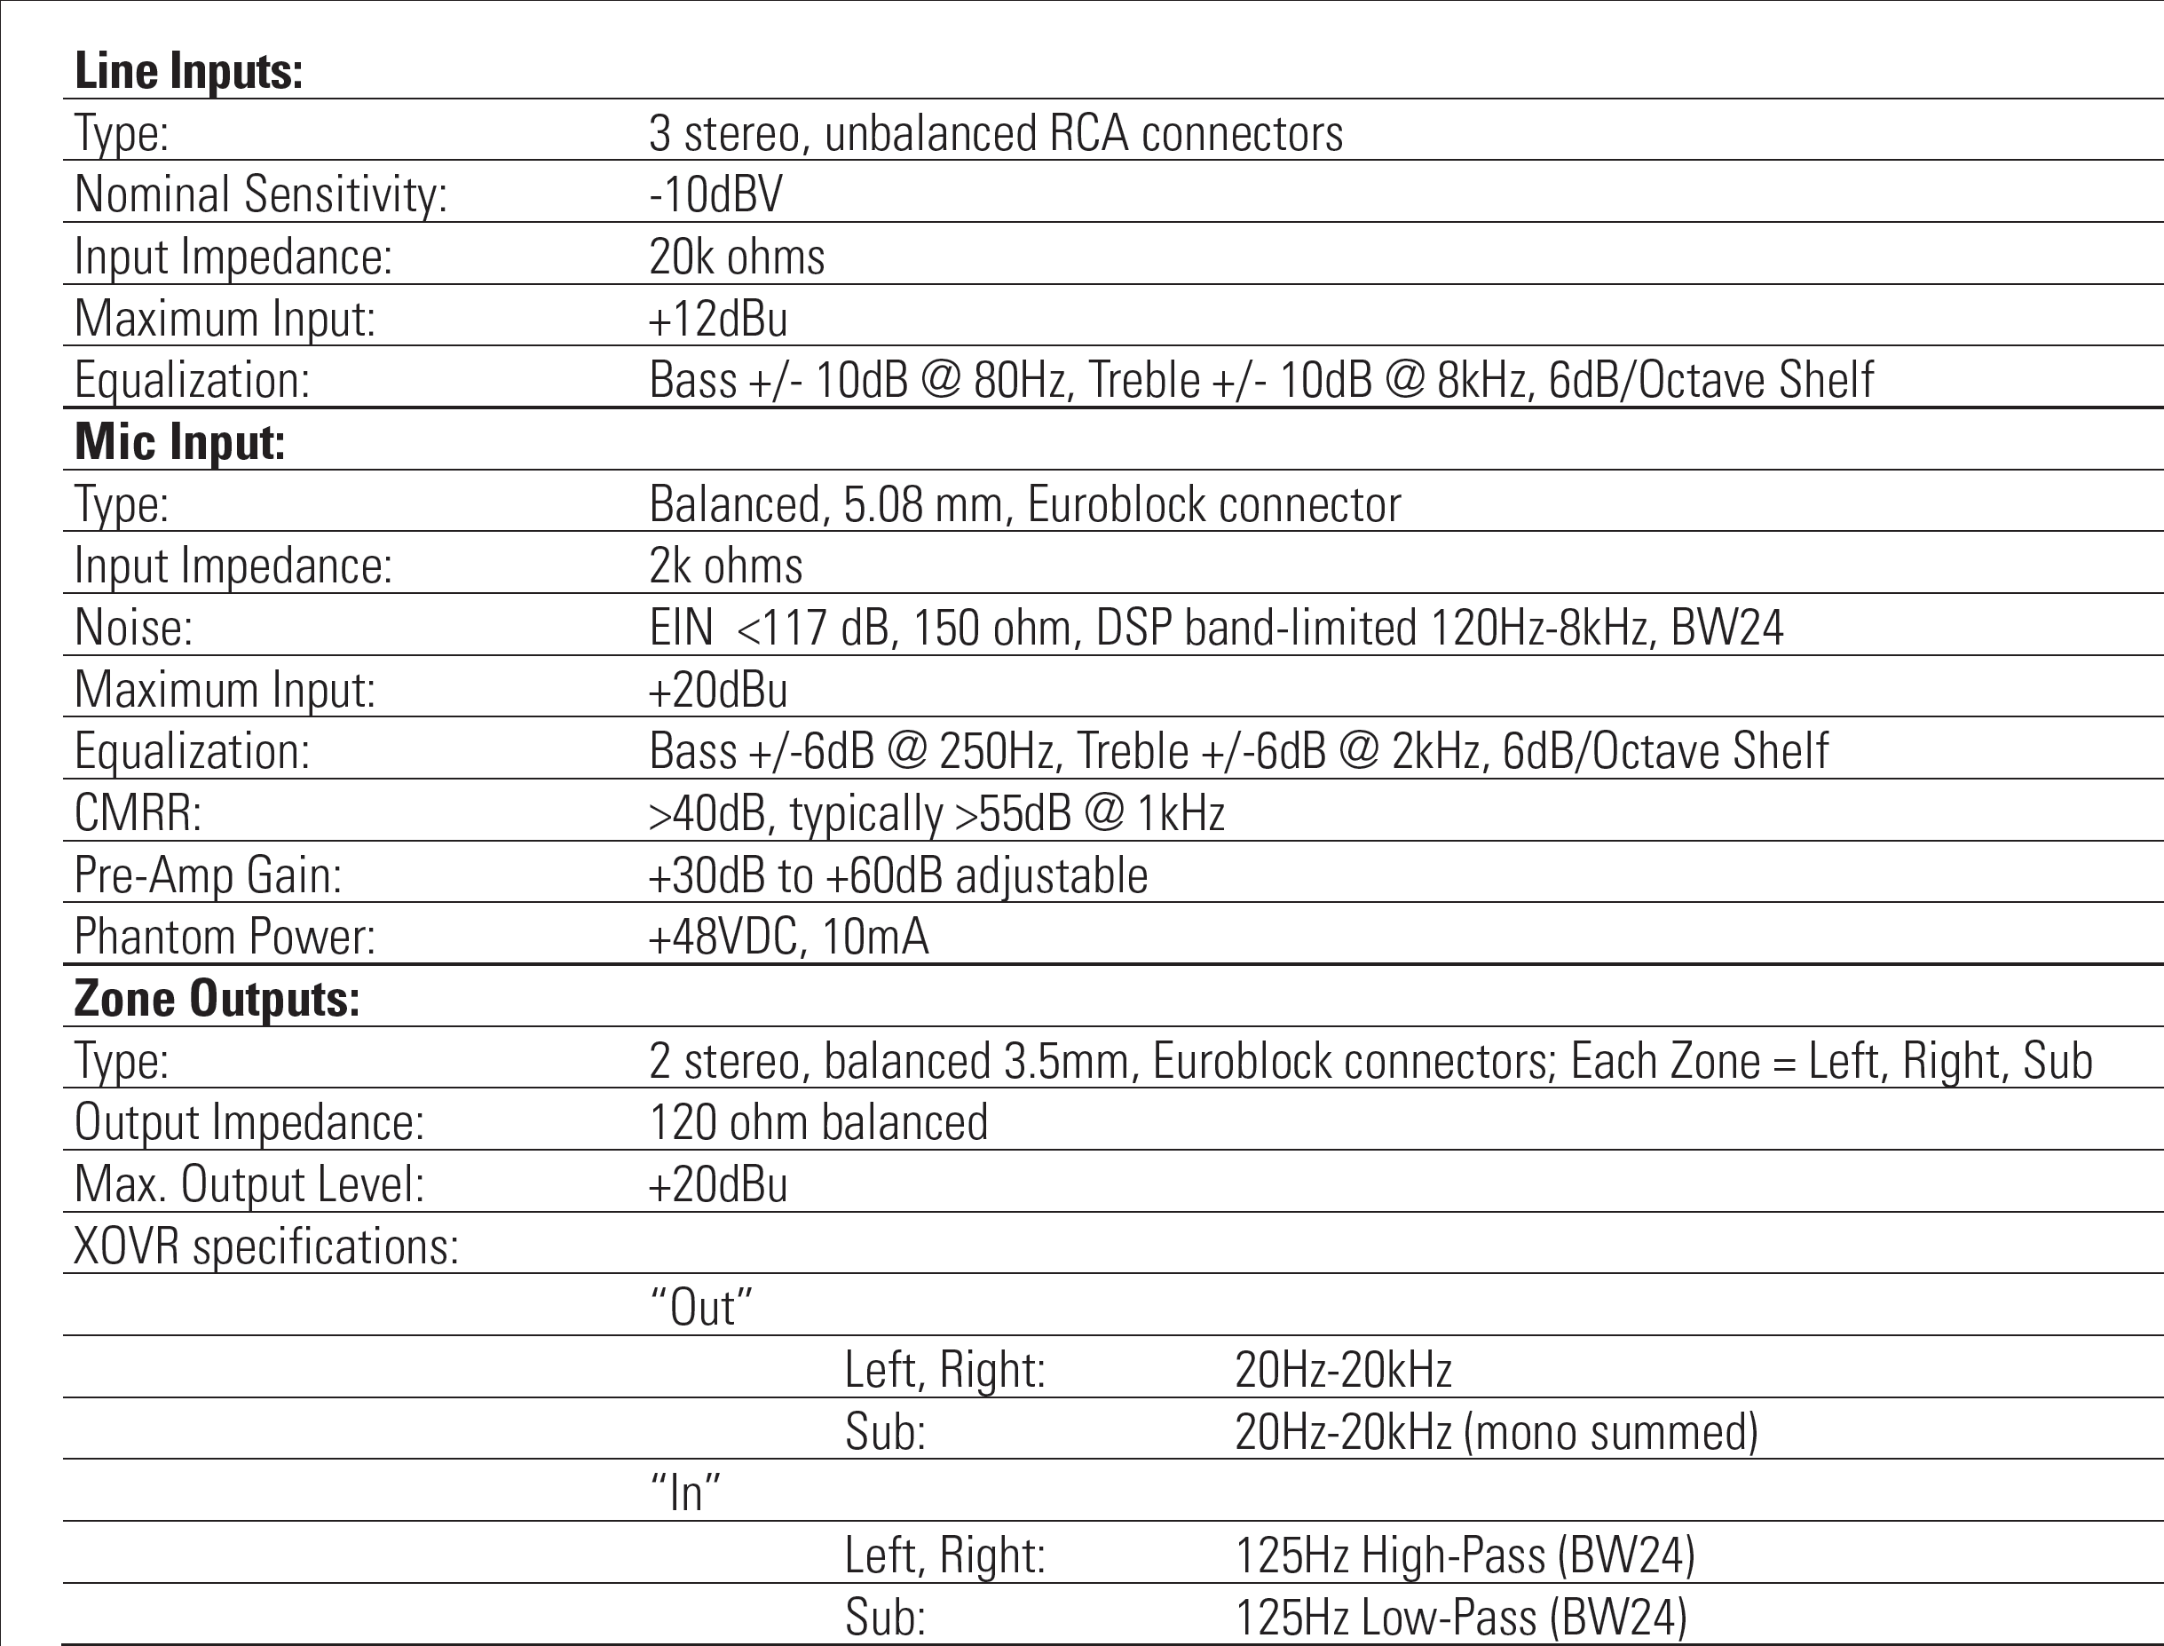
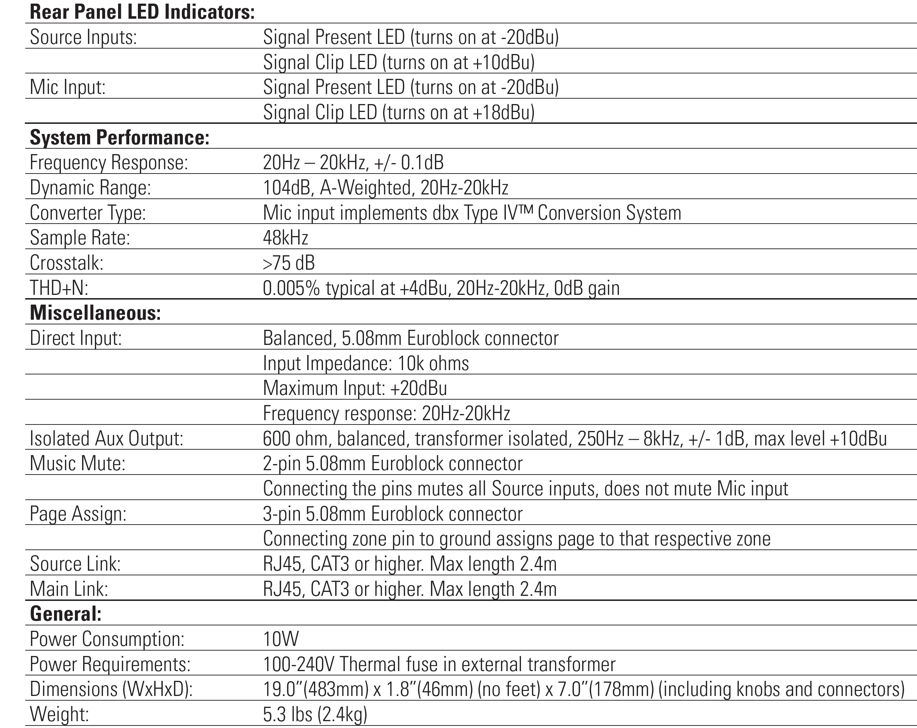
CSM-32 Spec Sheet

Slide 12
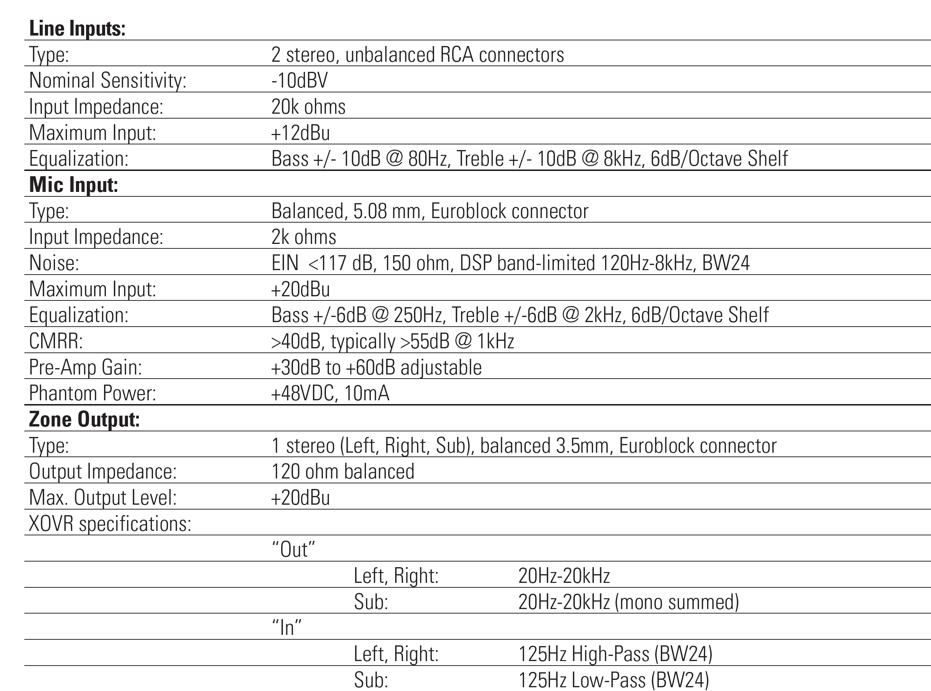
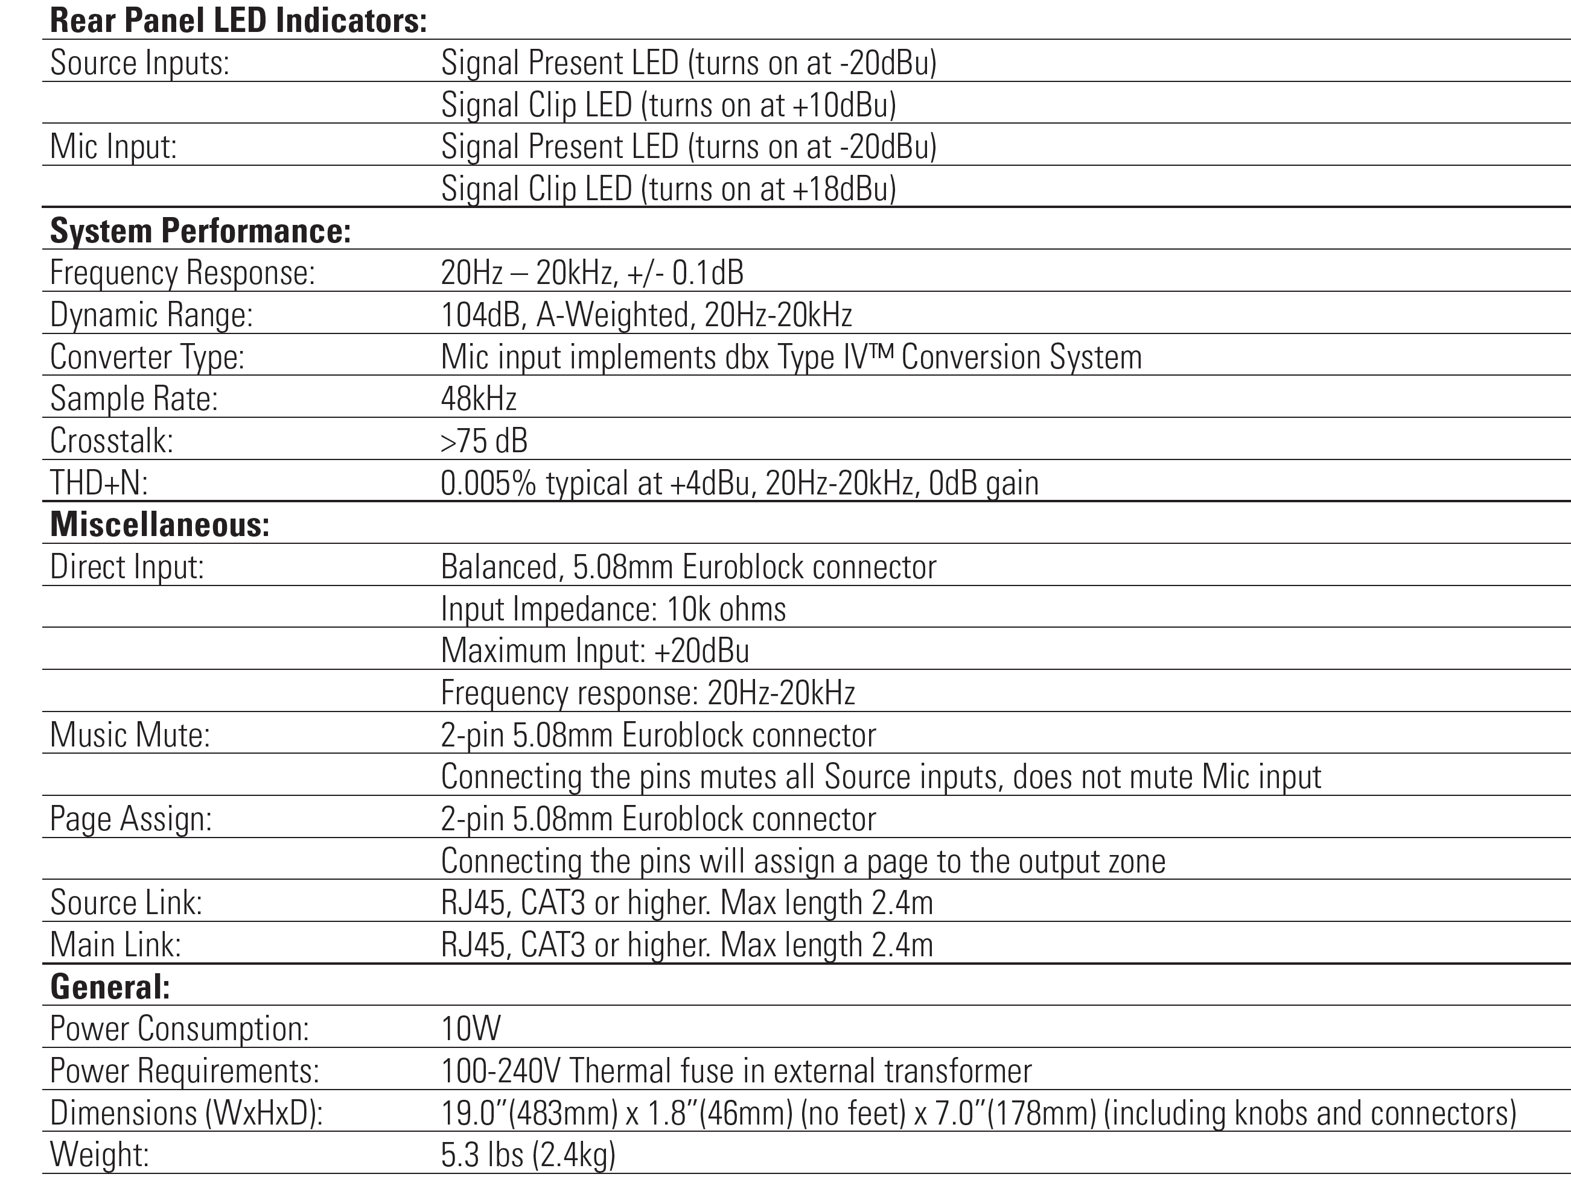
CSM-21 Spec Sheet

Slide 13
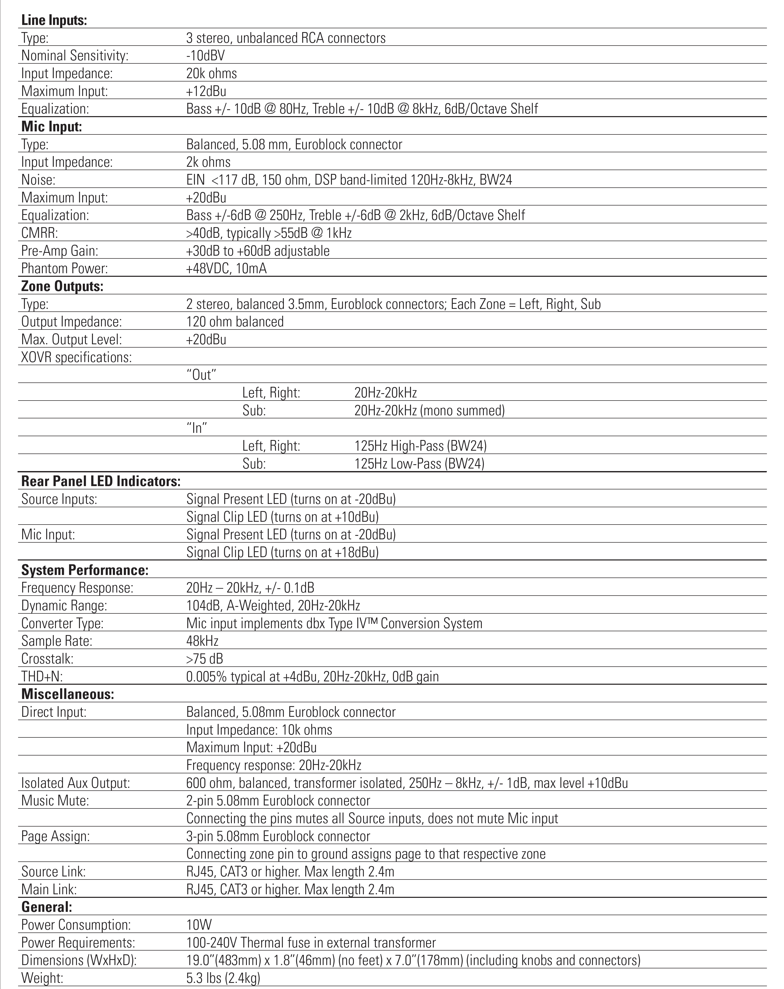
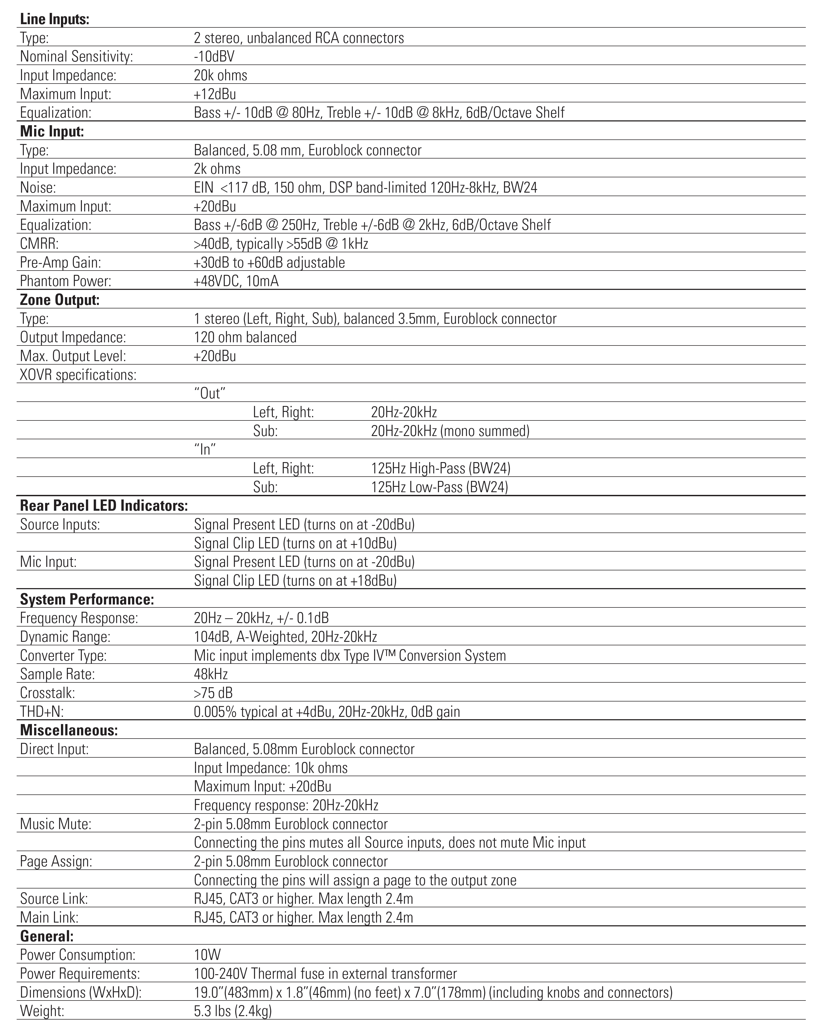
CSM-32/CSM-21 Spec Comparison
CSM-32
CSM-21

Slide 14
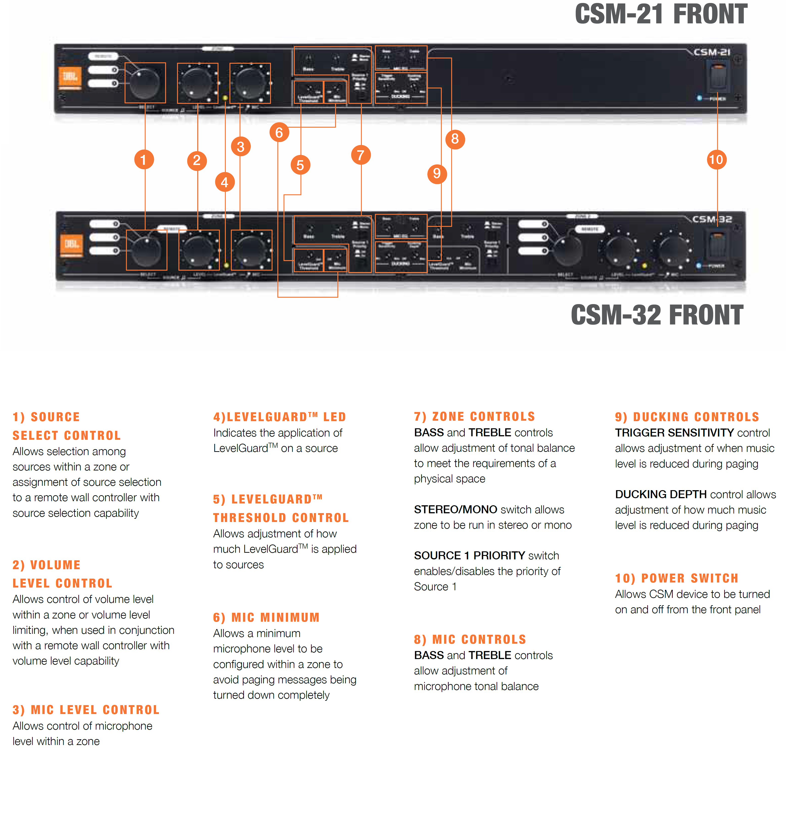
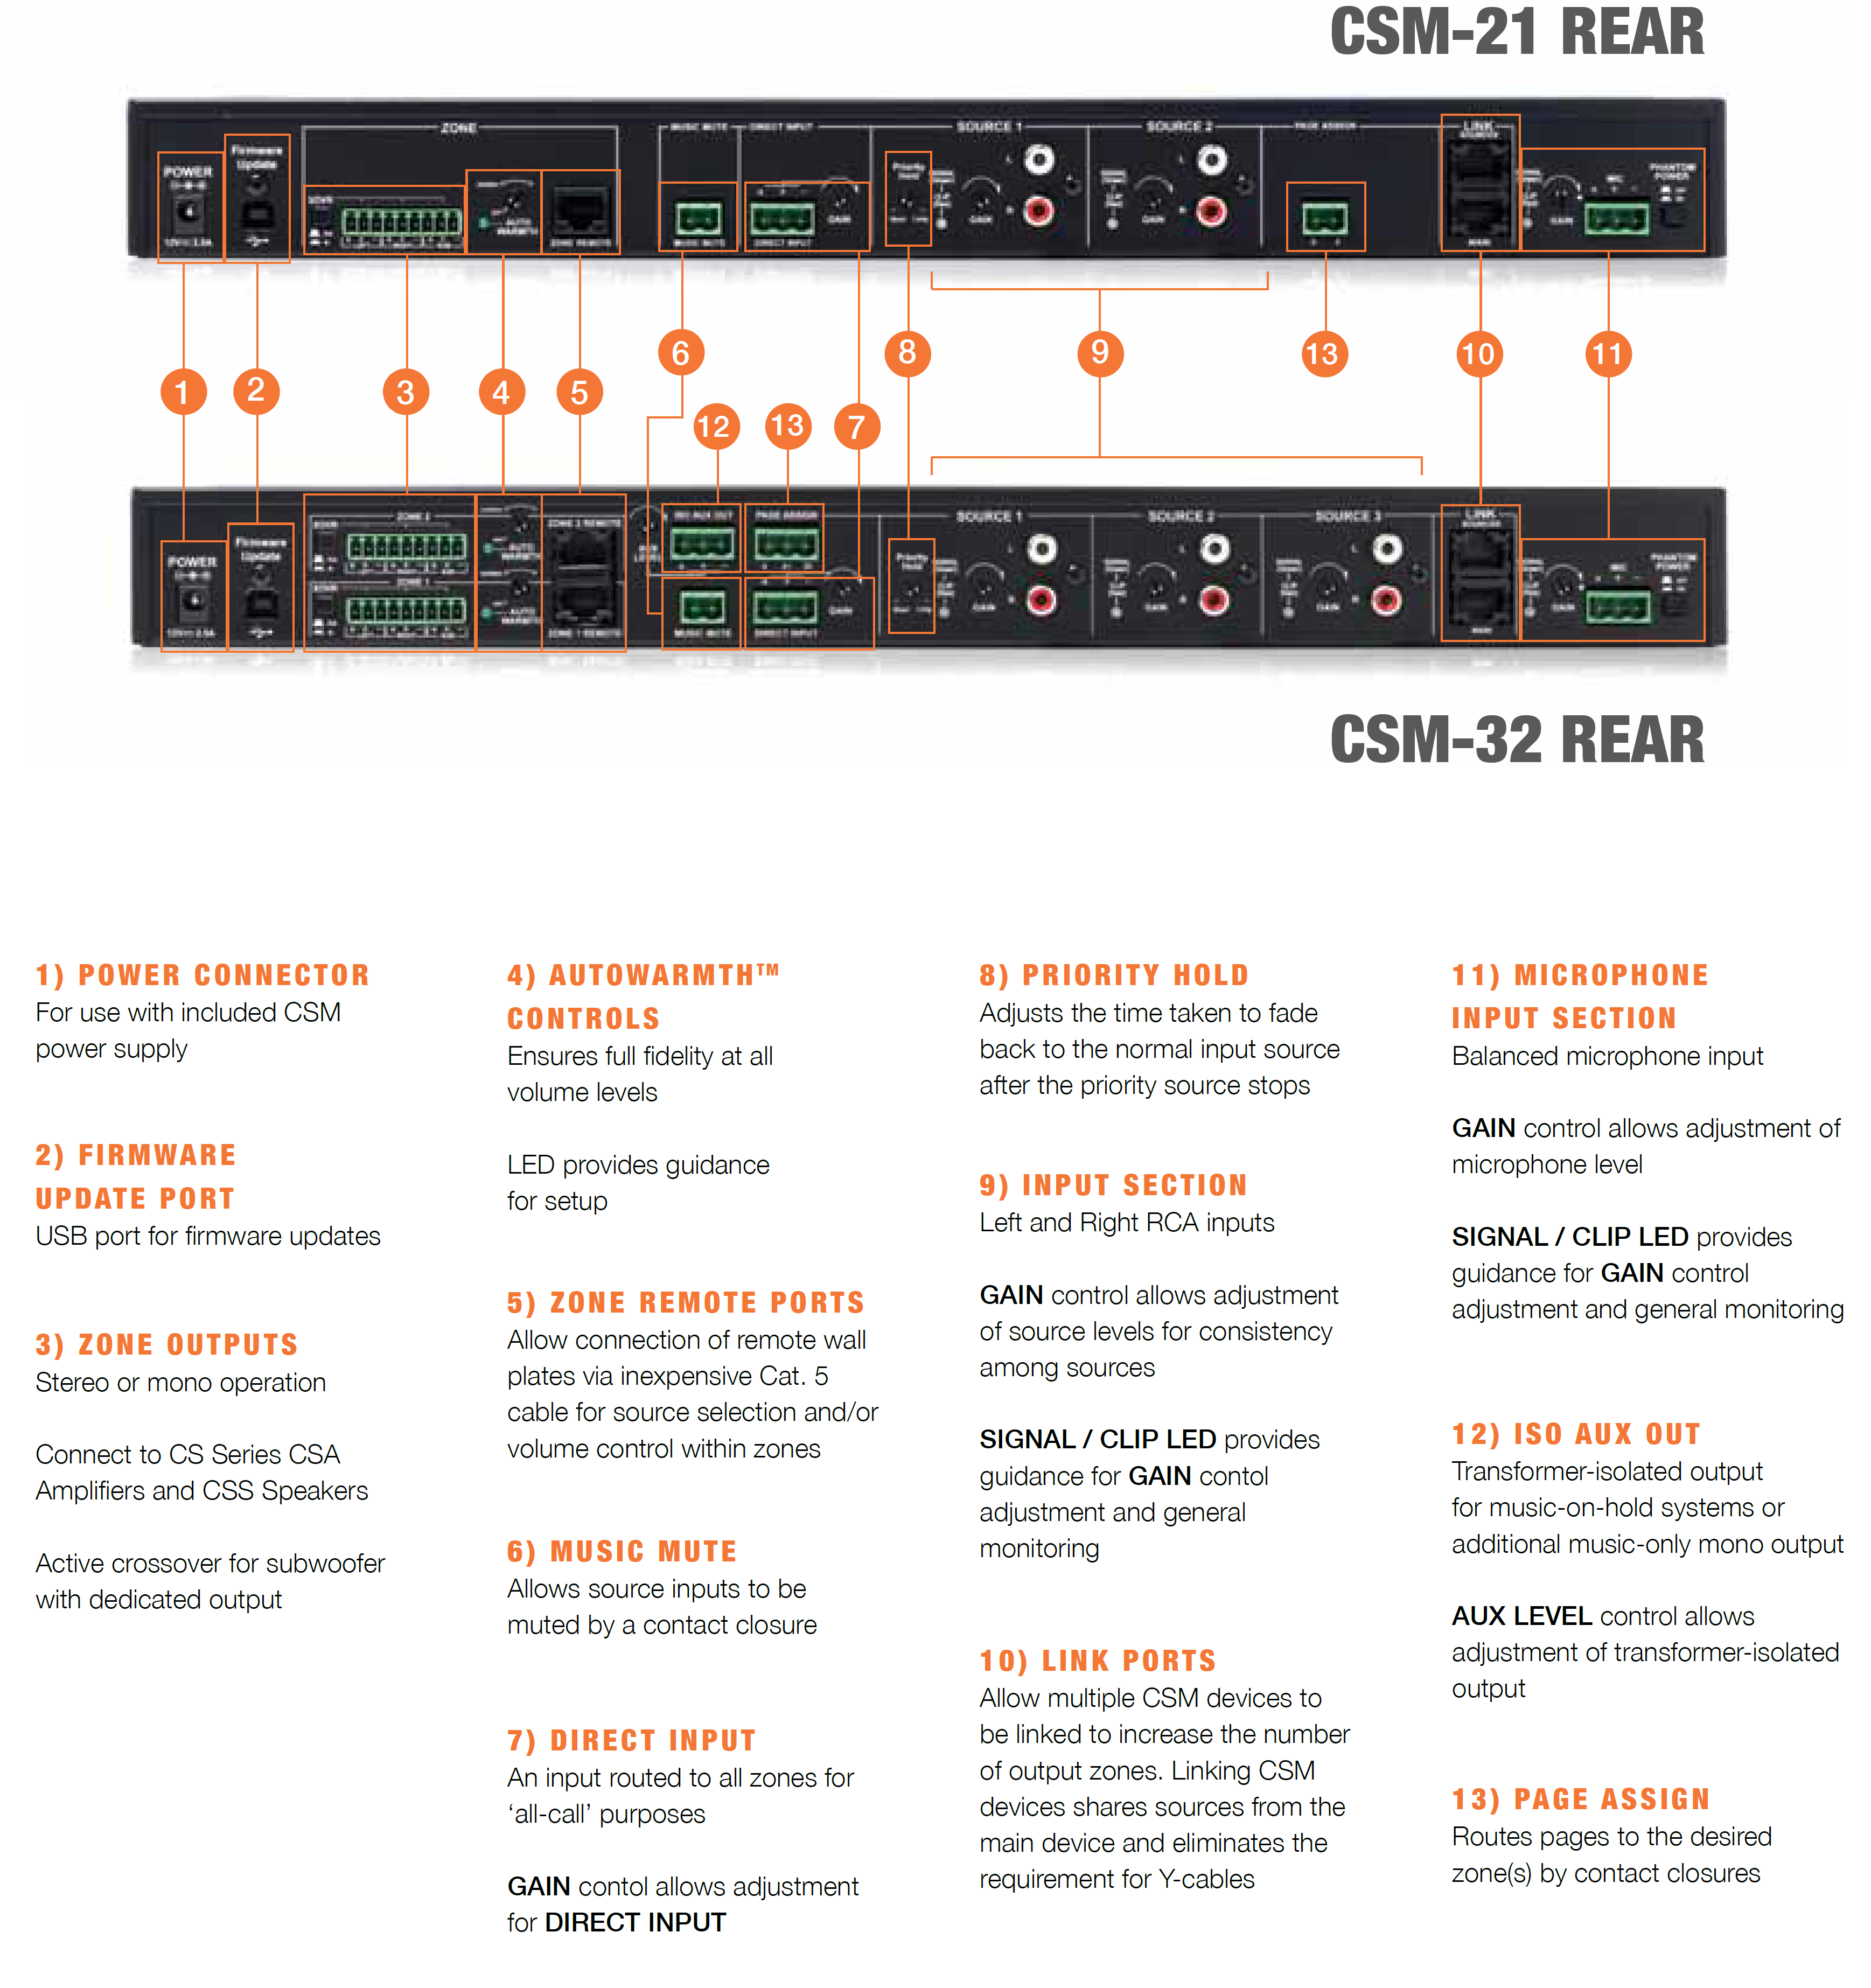

Slide 15
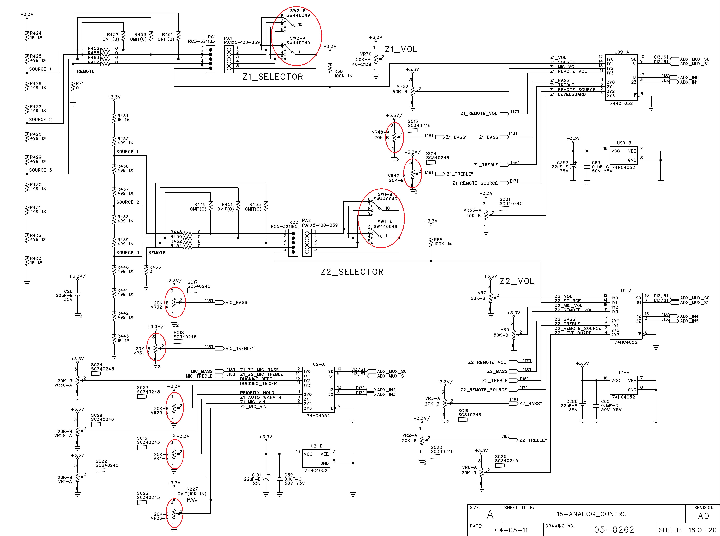

Slide 16
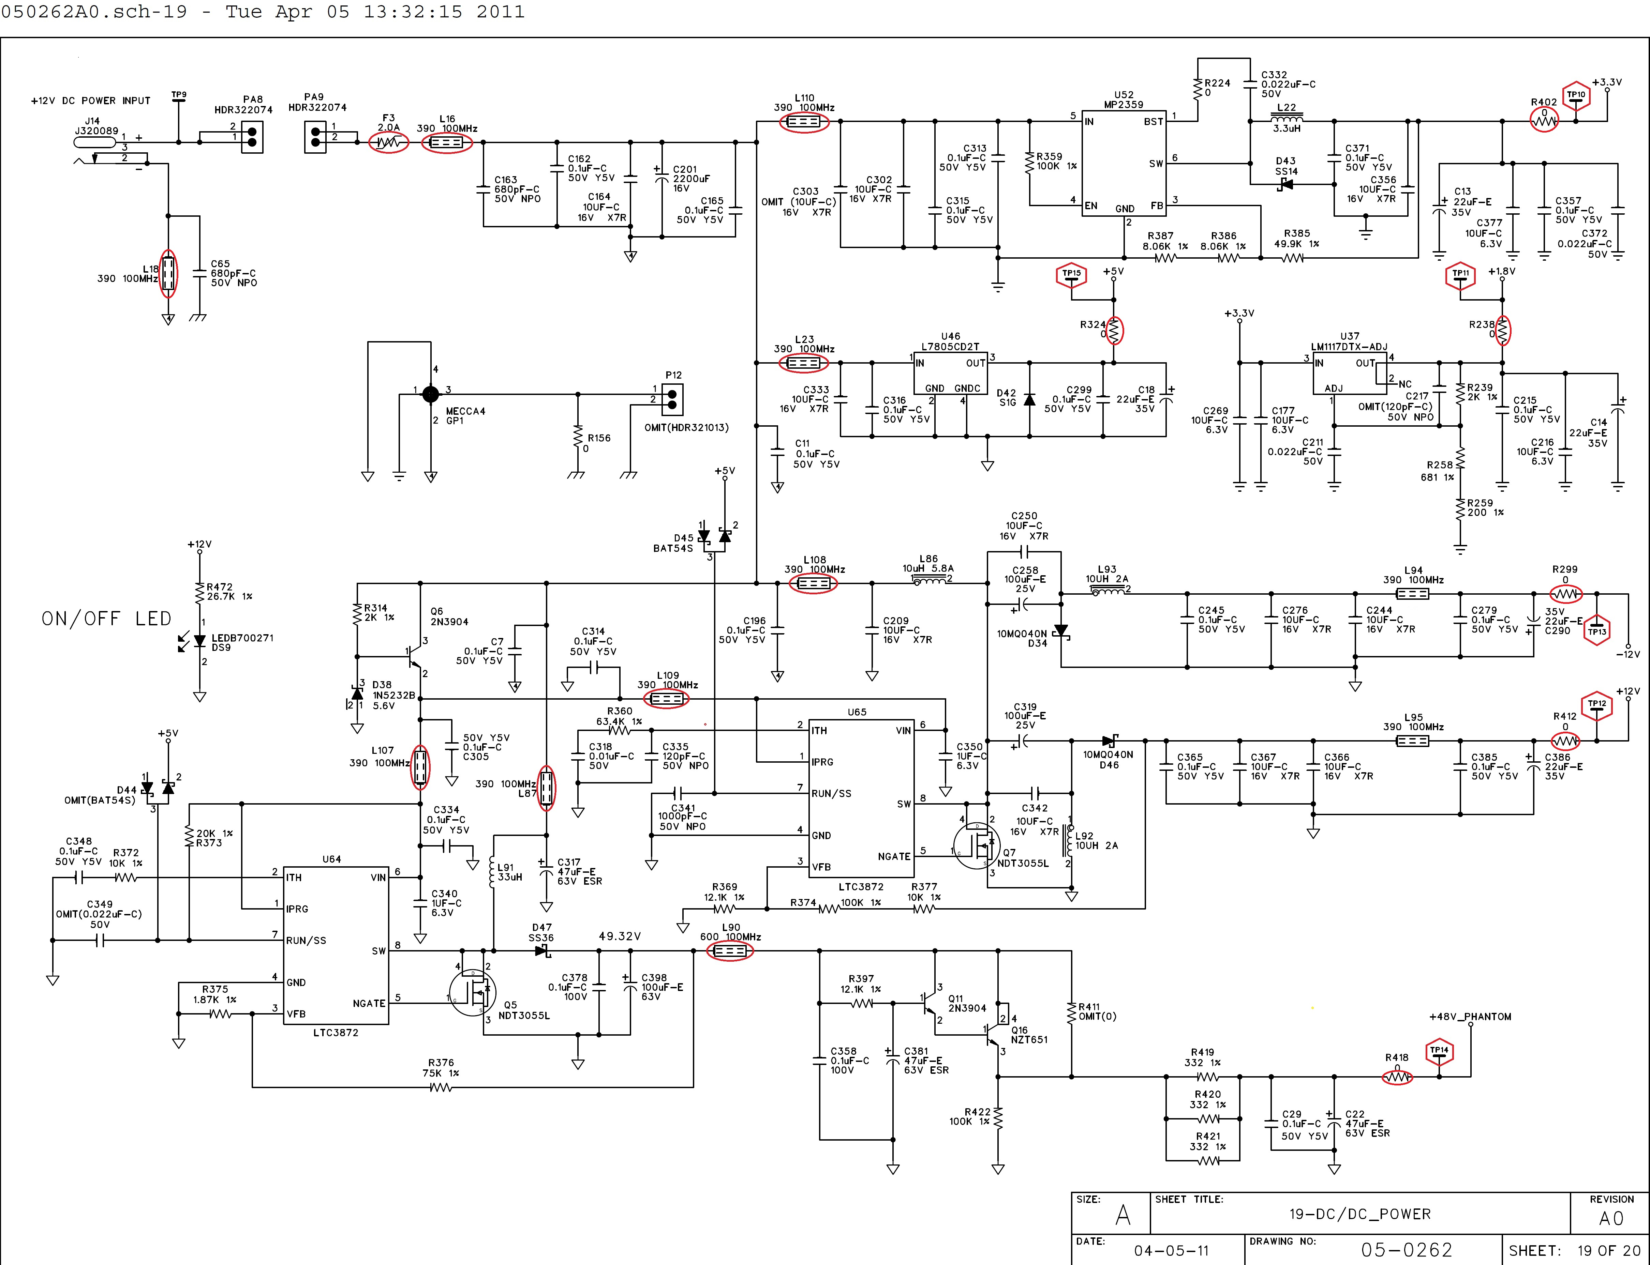

Slide 17
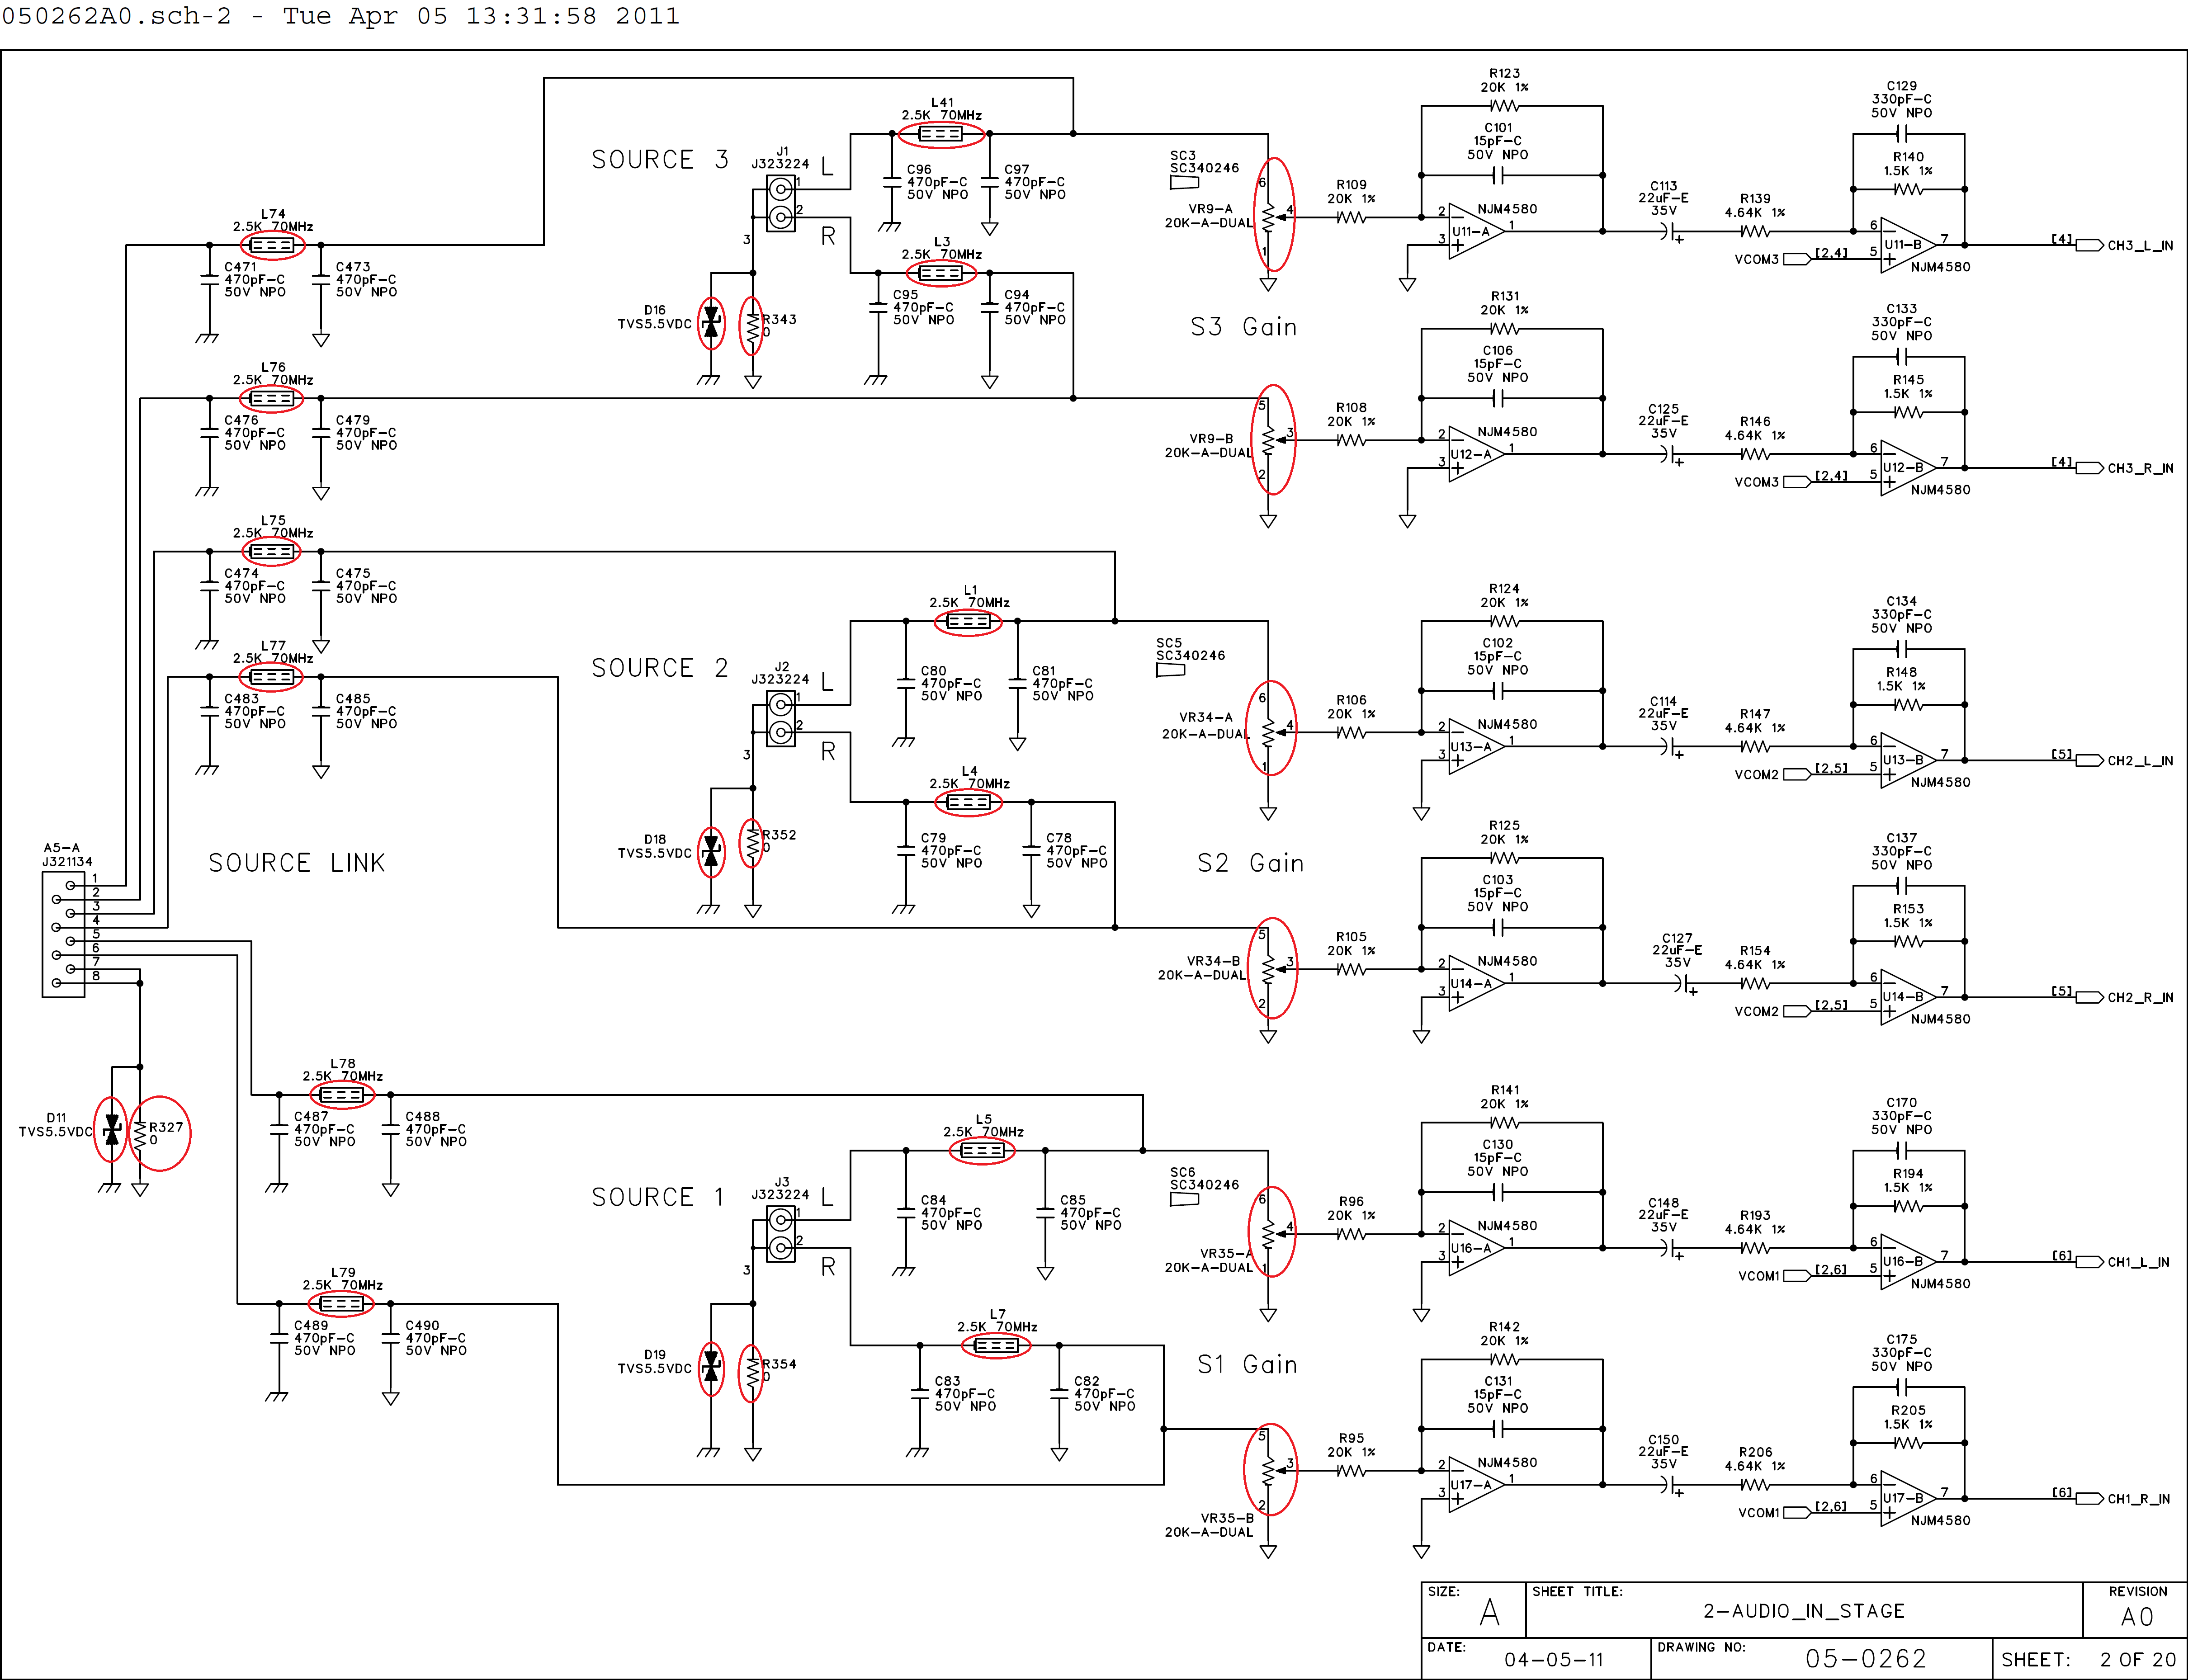

Slide 18
