Slide 1

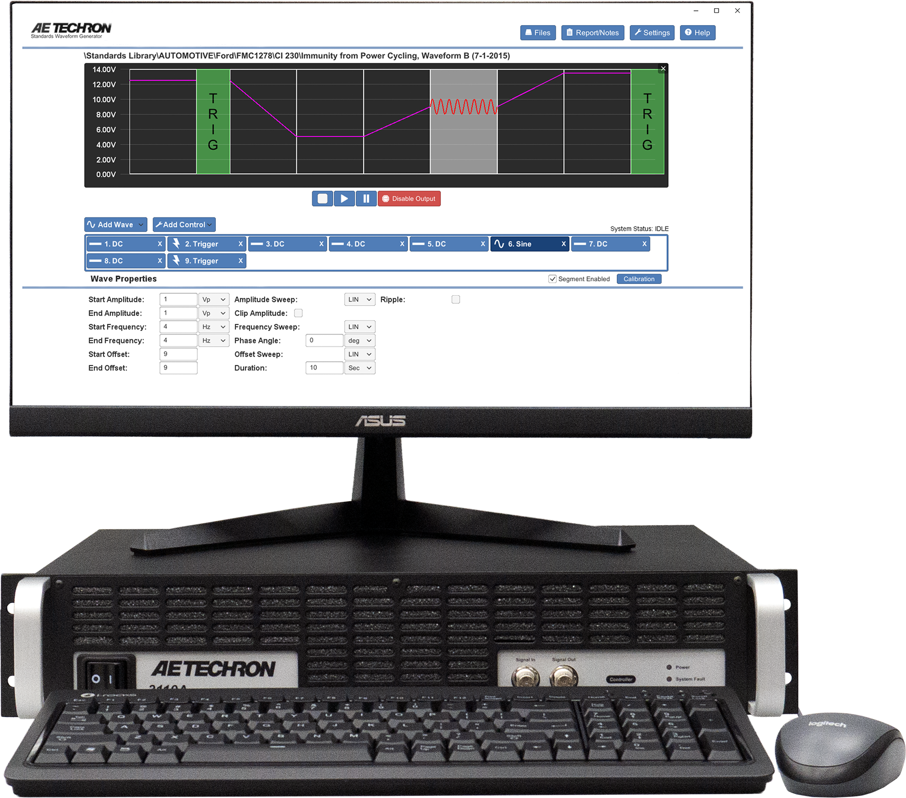
Expand Your EMC Testing Capabilities
WITH THE 3110A STANDARDS WAVEFORM GENERATOR
The AE Techron 3110A SWG creates virtually all waveforms required for EMC testing — including DC offsets, dropouts, and surges — with fast 2 µs rise and fall times
Up to 1 MHz EMC waveform generation
Faster execution of repetitive test sequences
Easy creation and modification of custom waveforms
3,700+ library of automotive, aviation, military, and industry standards
Learn more at aetechron.com

Slide 2
Powerful Waveform Generation for EMC Testing
DESIGNED TO SCALE WITH YOUR TEST SYSTEM
When combined with other AE Techron products,
the 3110A Standards Waveform Generator enables
powerful, intelligent EMC test solutions that scale
with your lab’s needs.
3,700+ library of automotive and industry tests
Free lifetime standards updates
Intuitive, engineer-friendly user interface
Local or network control with remote client software
Learn more at aetechron.com

Slide 3
Designed for Fast, Flexible EMC Testing
WITH THE 3110A STANDARDS WAVEFORM GENERATOR
AE Techron’s 3110A delivers fast waveform generation and flexible control, making it easy to adapt test
sequences as requirements change.
2 µs rise/fall times for fast transient simulation
Easy waveform editing and sequencing
Ideal for development, pre-compliance, and validation
Supports automated and remote test environments
Request a Demo at aetechron.com

Slide 4
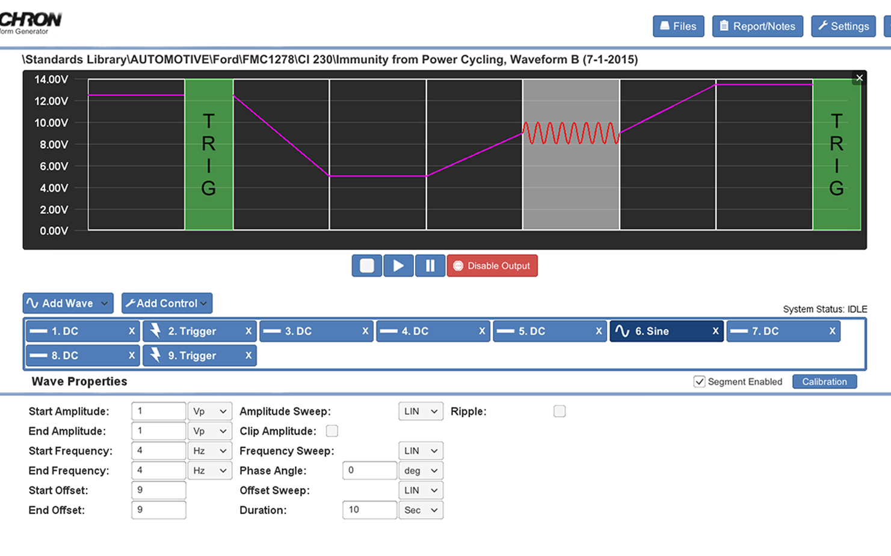
Simplify Standards-Based EMC Testing
WITH THE 3110A STANDARDS WAVEFORM GENERATOR
The 3110A simplifies standards-based EMC testing by giving engineers instant access to thousands of predefined test waveforms, without manual programming or complex setup.
3,700+ built-in standards tests
Rapid setup for compliance testing
Consistent, repeatable waveform generation
Reduce rework and setup errors
Request a Demo at aetechron.com

